Slide 1

DAB 304 Project Group – 5 Members
Nanbal Fompun
Viswanadha reddy goluguri
Delta joseph
Amith john varkey
Darshit Pradipkumar rana

Slide 2

PREDICTION OF BREAST CANCER

Slide 3
What is Breast Cancer?
The cancer starts in the breast where cells start to outgrow without control.
The kind of breast cancer depends on which cell start to outgrow.
Kinds of Breast cancer:
Invasive ductal carcinoma: The cancer cells grow outside of the ducts into other parts of the breast tissue.
Invasive lobular carcinoma: Cancer cells spread from the lobules to the breast tissues.

Slide 4
WHY WE CHOSE THIS DATASET?
Breast cancer is one of the common cancers in women these days.
In Canada alone, on an average, 14 women die everyday due to breast cancer.
Early detection can improve the survival rate of the person and the person could receive timely treatment.
The objective of the project is to enhance mutual exchange of knowledge in how to predict the breast cancer in advance given the characteristics of the nuclei.

Slide 5
TRADITIONAL METHODS
Traditionally, the breast cancer is detected by physician’s experience by observing the patients past record and symptoms of the person.
Conventional methods like Microsoft excel were used to predict the breast cancer by implementing the excel-based algorithms

Slide 6
WHY MACHINE LEARNING?
The main challenge for breast cancer detection lies in classification of tumours into malignant or benign. Machine Learning techniques helps to improve the accuracy of diagnosis.
Research has proved that physicians diagnose disease with 79%accuracy while machine earning techniques use 91%.
Machine learning is one of the ways where we can handle large chucks of unstructured data and identify the hidden patterns.

Slide 7
DATASET OVERVIEW
The dataset has 32 features which includes one categorical variable which is Diagnosis and used as the target variable.
The remaining 31 features are numerical where we have used them in our analysis
There are 10 features where each feature has mean, standard error and worst or largest of those features which resulted in 32 features in total along with the id_number.
The diagnosis variable is classified into 357 benign and 212 malignant.
The features are of a digitized form of a fine needle aspiration of a breast mass.

Slide 8
DATA OVERVIEW
The following are the attributes
ID number Diagnosis (M = malignant, B = benign) Ten real-valued features are computed for each cell nucleus: i. radius (mean of distances from center to points on the perimeter) ii. texture (standard deviation of gray-scale values) iii. perimeter iv. area v. smoothness (local variation in radius lengths) vi. compactness vii. concavity (severity of concave portions of the contour) viii. concave points (number of concave portions of the contour) ix. symmetry x. fractal dimension

Slide 9
DATA CLEANING
The dataset was almost clean except for null values in some columns.
There are null values in 6 columns which included concavity_mean,concave_points_mean,concavity_se,concave_points_se,compactness_worst,concave_points_worst.
In total, we have 13.70% of null values.
These null values were imputed by using forward fill method.

Slide 10

Data Exploration

Slide 11
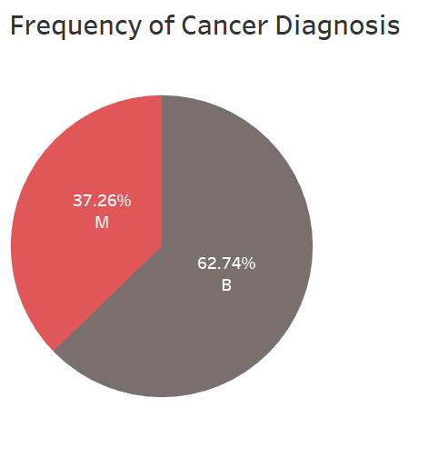
Description:
The pie chart indicates that 62.74% of records in the dataset is benign and 37.26% is malignant.

Slide 12
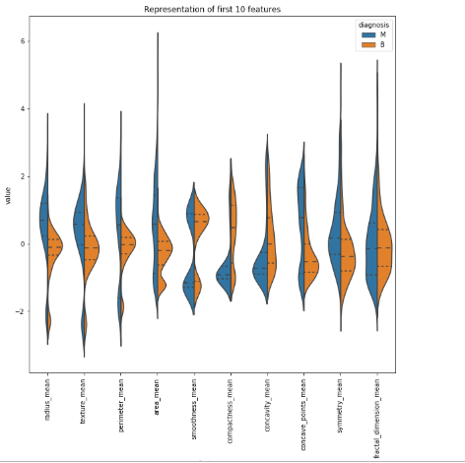
Representation of first 10 features.
We can observe that most of the data lies in between -2 to 2.
The data is for the mean of the 10 separate features respectively.

Slide 13
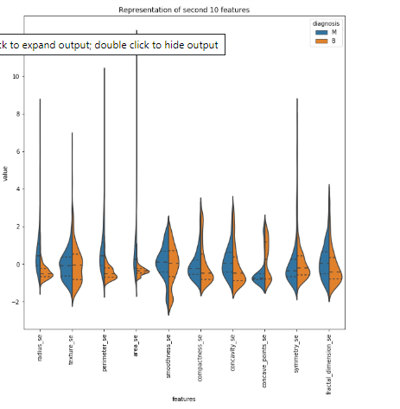
Representation of second 10 features
We can observe that most of the data lies in between -2 to 2.
The data is for the standard error of the 10 features.

Slide 14
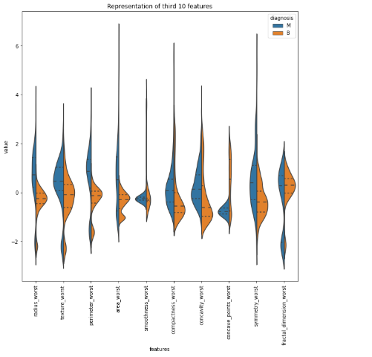
Representation of third 10 features
We can observe that most of the data lies in between -2 to 2.
The data is for the largest of three values.

Slide 15
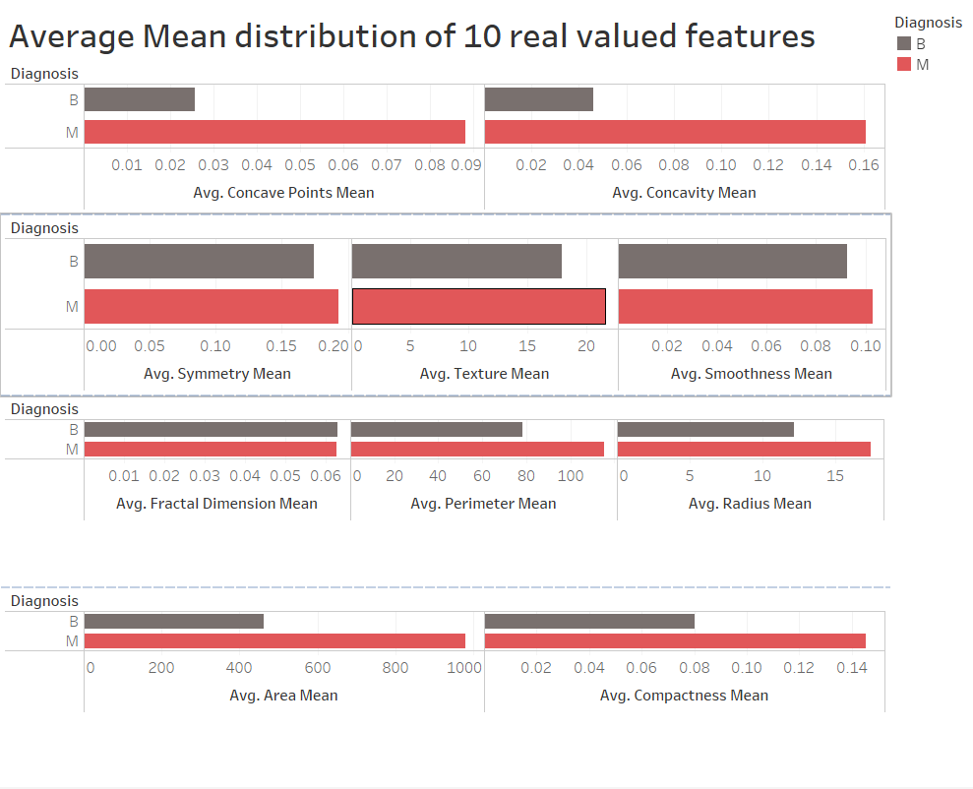
The distribution shows the mean value of all the features separately for benign and malignant.

Slide 16
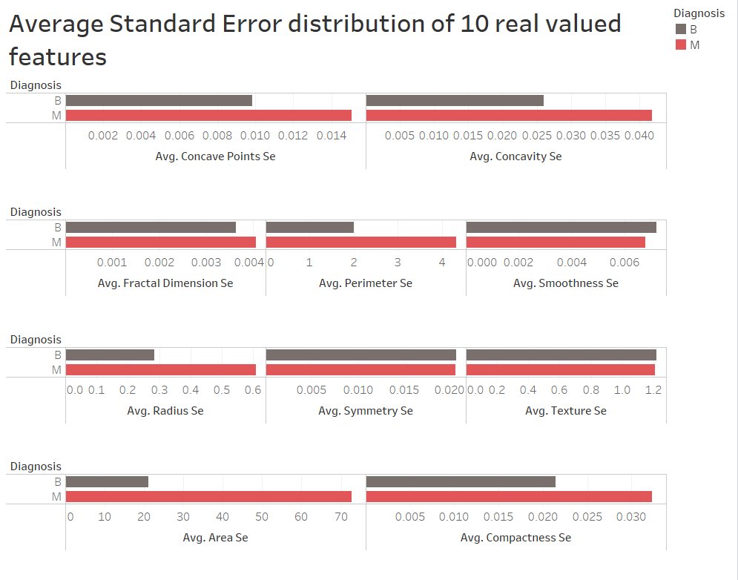
The distribution shows the standard error value of all the features separately for benign and malignant.

Slide 17
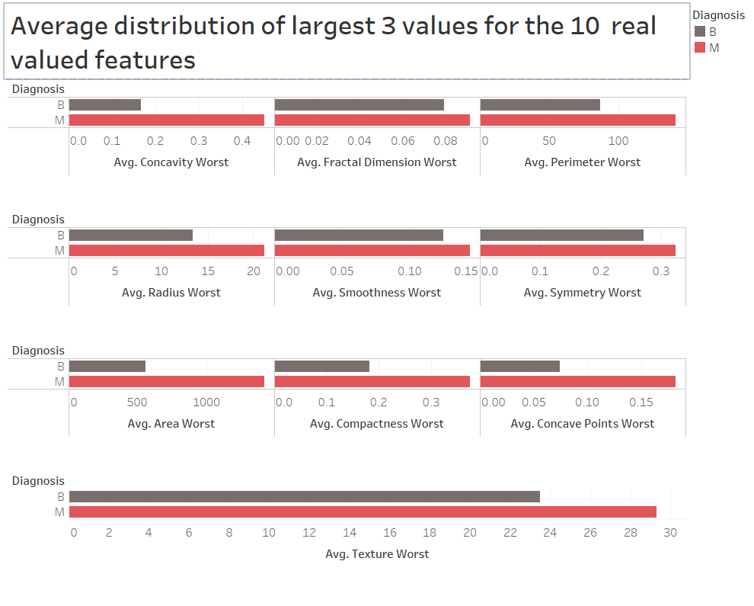
The distribution shows the value of largest three values separately for benign and malignant.

Slide 18
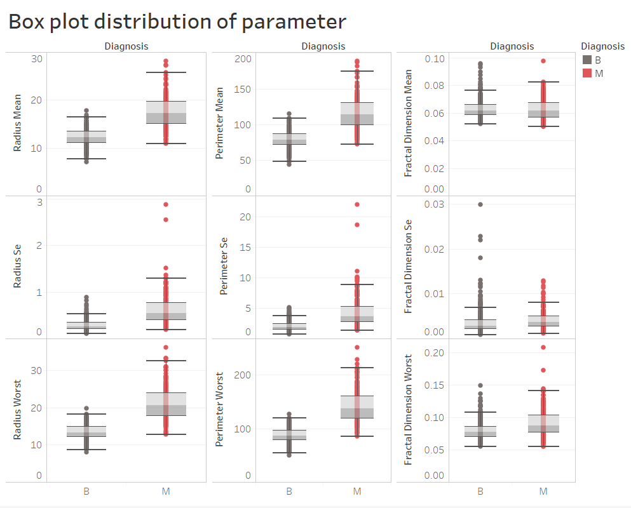
The distribution is the boxplot of features.
The dots are represented as the outliers for the variable.

Slide 19
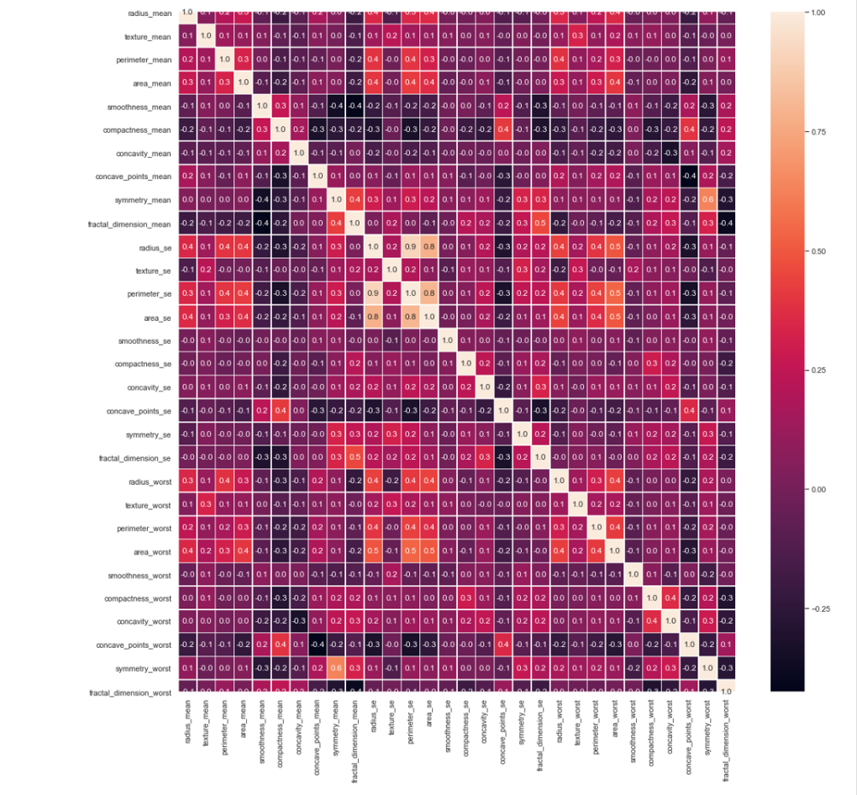
Correlation Plot:
By the representation we can see the relationship between the variables.

Slide 20
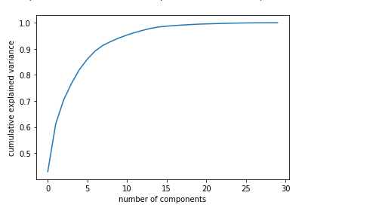
Feature Engineering:
First, we Scaled our feature data using the Standard scaler and transformed our scaled data.
We did feature engineering using Principle component analysis.
We selected 10 principle components as those components are explaining the maximum variance in the data.

Slide 21
Feature Engineering
We applied our PCA data to all the models and compared the accuracies of all other models with original data.
While comparing we came to know that PCA data gave better results compared to the original data.

Slide 22
KNN
The K nearest neighbors is a simple algorithm that takes all available observations and classifies new observation on the basis of a similarity metric.
Input for K Neighbors consist of k closest training set.
It is mainly used for statistical estimation.
KNN is used is also used in various fields like Healthcare, finance, image recognition, Handwritten recognition, etc.
Parameters used -> n_estimators : represents the number of trees in forest.

Slide 23
Logistic Regression
Logistic Regression is a supervised classification algorithm.
Logistic Regression targets categorical values as dependent variables instead of numbers.
It keeps a threshold value and classifies the data into classes based on the limit.

Slide 24
Decision Tree
A decision tree classifier is a non-parametric algorithm which applies a tree-like graph or model of choices and their possible costs, including chance event outcomes, resource costs, and utility.
Decision tree classification consists of two steps ,learning step and prediction step.
Model is build based on training data in learning step.
Model is used to predict the training data in the prediction step
Parameter used -> max_depth.

Slide 25
Random forest
Random forest classifier is a combination of decision trees from randomly selected subsets of the training data.
It averages the effect from various decision trees to determine the final class of the test object
Parameters used -> n_estimators: represents the number of trees in forest.

Slide 26
Gradient Boosting
Gradient boosting regression is one of the machine learning techniques which is used for both regression and classification problem.
Gradient boosting classifier algorithms combine weak learning models to create a strong predictive model. For example, the method converts weak models such as decision tree into strong model
Each tree is a fit on modified version of original dataset.
Parameter used -> loss function is optimized using grading descent. It is used for changing target variable for each tree. We also used the learning rate parameter which are values which range from 0 to 1.

Slide 27
MODELLING
In this project, we used five predictive classification models; The K-Nearest Neighbors Classifier, Logistic Regression model, Decision Tree Classifier, Random Forest Classifier and the Gradient Boosting classifier.
Models were evaluated on four metrics
Accuracy score: The number of correct predictions made by our model divided by the total number of observations.
Precision score: The ratio of the correctly predicted classes to the total predicted positive observations.
Recall Score: The number of correctly predicted classes divided by all the observations in the actual class.
F1 Score: The weighted average of the recall and Precision score.

Slide 28
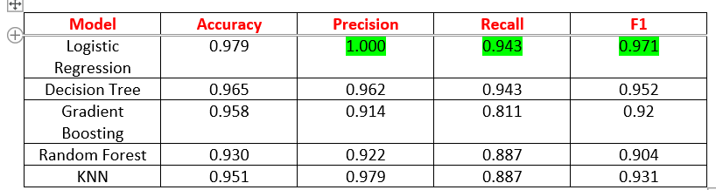
Results:

Slide 29
Challenges
The major challenge we had while implementing this project was the selection of which model to implement as all our models gave high accuracies based on the evaluation metrics which we explored.

Slide 30
Conclusion
The best model to predict diagnosis of a cancerous tumor in the breast is the Logistic Regression Model. This is due to a high precision score of 1.0, recall score of 0.943 and an f1 score of 0.971 as highlighted in the previous table.
Using this model we can analyze whether the tumor is malignant or benign based on the features of cell nucleus.
But we can improve our model efficiency by using neural network and applying more feature engineering methods.
Mutual exchange of knowledge is an added advantage by taking this project.

Slide 31
References
https://www.kaggle.com/uciml/breast-cancer-wisconsin-data
https://scikit-learn.org/stable/modules/generated/sklearn.metrics.confusion_matrix.html
https://scikit-learn.org/stable/modules/generated/sklearn.ensemble.GradientBoostingClassifier.html
https://scikit-learn.org/stable/modules/generated/sklearn.decomposition.PCA.html
https://www.analyticsvidhya.com/blog/2018/04/a-comprehensive-guide-to-understand-and-implement-text-classification-in-python/

Slide 32
The end

